Slide 1

Data allocation in distributed database systems
IT 897 Minor Project
Guided By – Dr. Shrutilipi Bhattacharjee
Presented By – Nikhil verma ( 222IT026 )

Slide 2
Introduction
In a distributed database system main costs are transmission of data among sites for query execution. The solution proposed in the research aims to minimize the cost of transactions in distributed database system by allocating the fragments to sites in such a manner that the amount of data that need to be transmitted is minimized.

Slide 3
Problem Statement
In a distributed database system cost of data transmission is affected by how the fragments are allocated to the sites. The data allocation problem is an NP-hard optimization problem. In this project we have implemented a hybrid of two metaheuristics algorithm for generating solution for data allocation in distributed database.

Slide 4
Literature survey
Author | Title | Summary
Rosa Karimi Adl, Seyed Mohammad, Taghi Rouhani Rankoohi | A new ant colony optimization based algorithm for data allocation problem in distributed databases | Solution to DAP problem using Ant colony optimization.
Mostafa Mahi, Omer Kaan Baykan, Halife Kodaz | A new approach based on particle swarm optimization algorithm for solving data allocation problem | Solution to DAP problem using particle swarm optimization.
Umut Tosun | Distributed Database Design using Evolutionary Algorithms | Hybrid solution for QAP and DAP problem using genetic algorithm, fast ant system and robust tabu search.

Slide 5
Methodology
Solution to DAP is a vector of dimension 1Xm where m is the number of fragments and range of values in a solution will be an integer value between 0 and n-1, where n is the number of sites.
The cost of a solution is calculated as follows:
The data allocation cost can be represented as the sum of direct and indirect transaction-fragment dependencies . ( Cost = Cost1 + Cost2)
A transaction t and fragment f have a direct dependency if the data from the container site of f are transmitted for every execution of t.
Cost1 = sum(uc X stfr)
There is an indirect dependency if the data need to be transmitted to a site other than from where the transaction originates.
Cost2 = sum(frdep X uc)
Where uc = unit cost of data transmission from one site to another.
stfr = site fragment dependencies.
frdep = inter fragment dependencies.

Slide 6
Methodology CONT.
First we will generate initial population of solutions randomly.
For every solution in the population we will apply Differential Evolution Algorithm and Variable Neighbourhood Search and replace that solution if an better solution is found.
We will perform the above steps for a number of iterations that will result in optimized population and we select the solution with minimum cost from the population.

Slide 7
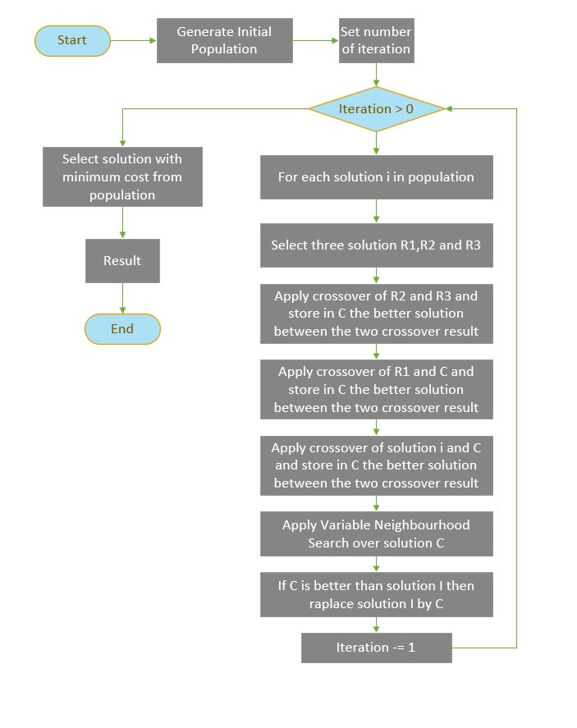
Flowchart

Slide 8
Differential Evolution Algorithm
For every solution Si in population :
1. Select three different solution.
2. For every solution on population calculate NewCost where NewCost = Max(Cost) - cost(solution)
3. select a value R between zero and NewCost and select three solution R1,R2,R3 that have NewCost less than or equal to R.
4. Select R2 and R3 and perform two point crossover and store as C the solution with lesser cost.
5. Perform crossover between C an R1 and update C with solution with lesser cost solution.
6. Apply crossover between Si and C and update C with solution with lesser cost solution.
7. Apply Variable Neighbourhood Search over solution C.
8. If solution C is better that Si then update Si with C.

Slide 9
Variable Neighbourhood Search
for a solution S:
1. Generate a solution Y form X of same structure.
2. Generate a new solution Z from Y by changing 3 sites randomly
If Z is better than Y then update Y with Z.
3. Repeat step 2 five times.
4. If Y is better than X then update X with Y.
5. Repat step 2,3,and 4 ten times.

Slide 10
Results
Population size = 200
DAP instance size (number of fragments and sites) = 5
Number of iteration = 50
Cost of solution with DEVNS = 320242
Minimum cost of solution with DEVNS = 4207

Slide 11
Identified Problems and suggested correction
Problems - In the two point crossover function the solutions are updated with new solution that are found by two point crossover operation which some times gives the solution worse than the initial solutions.
Solution – Instead of necessarly updating the solutions with the crossover result we first check if the solutions found by crossover is better than the initial solutions. If it is found to be better than we update the initial solutions by crossover solutions. This prevents movement into backward direction.

Slide 12
Results after modification in crossover function
Population size = 200
DAP instance size = 5
Number of iteration = 5
Cost of solution with DEVNS = 246989
Minimum cost of solution with crossover function mentioned in base paper = 5192
Minimum cost of solution with modified crossover function = 5178

Slide 13
Future Work
Repeat the experiment with different instance size.
Try other meta-heuristic algorithms.

Slide 14

Thank You

